Slide 1


Sentiment Analysis on Movie Reviews
Project focused on predicting movie review sentiments using Logistic Regression.
Dataset: IMDB movie reviews. Tools used: Python, Scikit-learn, NLTK, Matplotlib.
Simran Tyagi (202410116100208)
Shefali Yadav (202410116100195)
Tanisha Jain (202410116100217)
Vishal Chaturvedi (202410116100248)

Slide 2
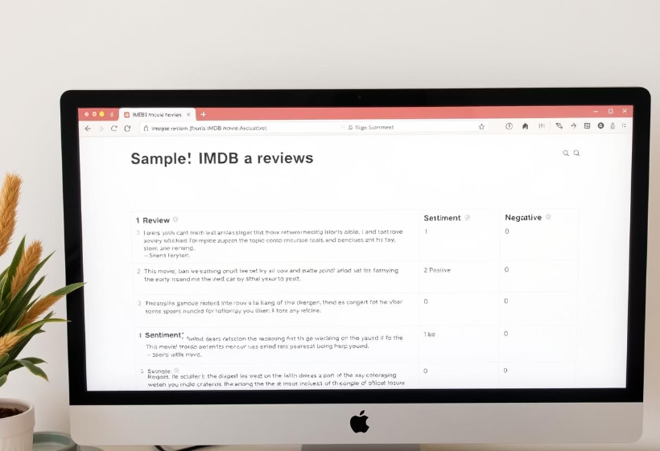
Dataset Loading and
Overview
Dataset Details
50,000 reviews total
25,000 positive, 25,000 negative
Text and sentiment label (0 or 1)
Publicly available source
Data Preview
Sample of reviews and labels to understand structure.

Slide 3
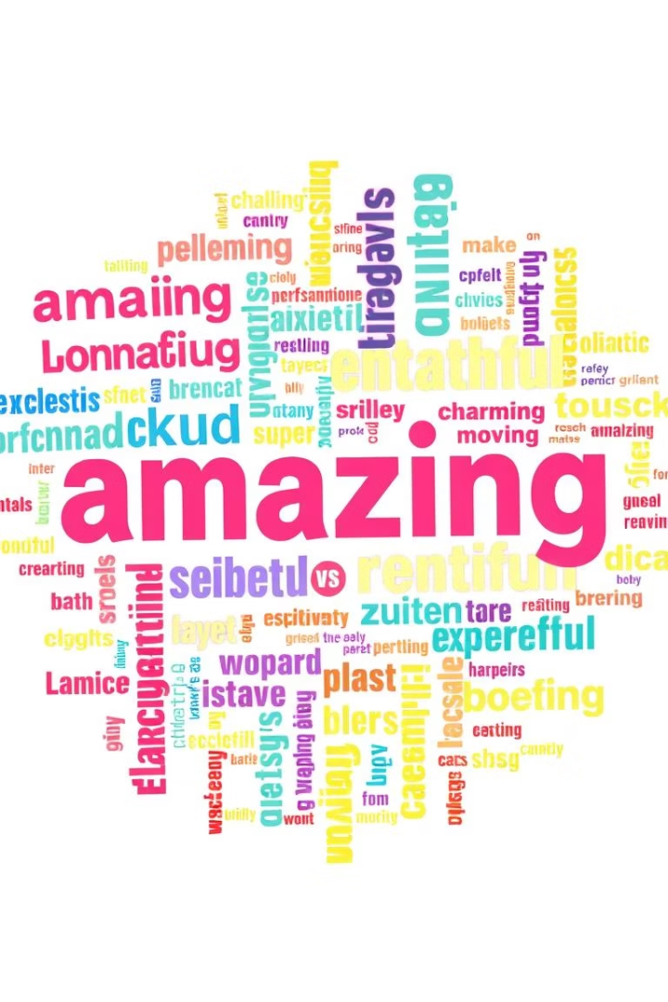
Exploratory Data Analysis
Sentiment Distribution
Word Clouds
Balanced positive and negative review counts
Visualize most frequent words in positive and negative reviews
Insights
Initial understanding of key text features

Slide 4
Data Preprocessing
Text Cleaning
Tokenization
Stop Word Removal
Remove punctuation, HTML, specials
Split text into words/tokens
Exclude common words like "the", "is"
Stemming/Lemmatization
Vectorization
Reduce words to root form
Convert text to numeric format (TF-IDF)

Slide 5

Model Training
Data Splitting
80% training, 20% testing
Algorithm Choice
Logistic Regression selected for classification
Training Process
Fitting model on training set data
Hyperparameter Tuning
Optional step to improve model accuracy

Slide 6
Model Evaluation
Key Metrics
Confusion Matrix
Accuracy, Precision
True positives, negatives, false positives, and negatives
Recall, F1-Score
Visualized as heatmap for clarity

Slide 7
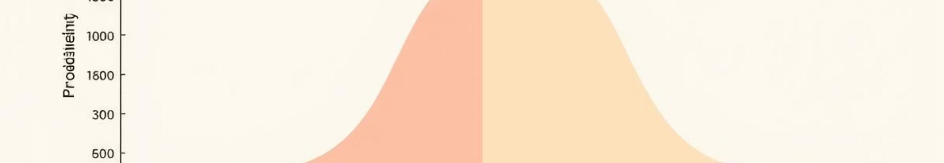



Result Visualization
Example Positive Review
Review text with predicted positive sentiment
Example Negative Review
Review text with predicted negative sentiment
Probability Distribution
Histogram of predicted sentiment probabilities

Slide 8

Conclusion and Next Steps
Summary
Successful sentiment analysis on IMDB reviews
Model Performance
Achieved strong accuracy with Logistic Regression
Future Work
Explore advanced models like deep learning
Improve text preprocessing techniques
Apply on other sentiment datasets

